Slide 1

Anomaly Detection in Network Traffic with K-means Clustering using PySpark
Algorithms for Big Data
Tiago Filipe Martinho Soares
Notes:
The problem and its respective solution are described in Sandy Ryza’s “Advance Analytics with Spark: Patterns for Learning From Data at Scala” book, chapter 5. However, in this book, the solution is written in the Scala programming language while the solution presented in this report is written in Python

Slide 2

Problem description and dataset
The goal is to find k clusters that allow for an optimal grouping of connections based on their type. Any connection not close to one of these clusters is a potential anomaly in the dataset.
The dataset contains about 4.9 million connections and is 708MB in size.
0,tcp,http,SF,181,5450,0,0,0,0,0,1,0,0,0,0,0,0,0,0,0,0,8,8,0.00,0.00,0.00,0.00,1.00,0.0 0,0.00,9,9,1.00,0.00,0.11,0.00,0.00,0.00,0.00,0.00,normal.
Notes:
As previously mentioned, the algorithm used for solving this problem is K-means clustering, an unsupervised learning technique and one of the most popular clustering algorithms. This algorithm tries to find k clusters in a dataset, a hyperparameter given by the data scientist trying to solve the problem. Finding a good value for k is one of the main points of this project and it allows for grouping of connections based on their type. Any connection not close to one of these groups/clusters is a potential anomaly in the dataset.

Slide 3

Approach

Slide 4
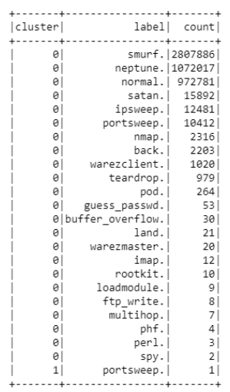
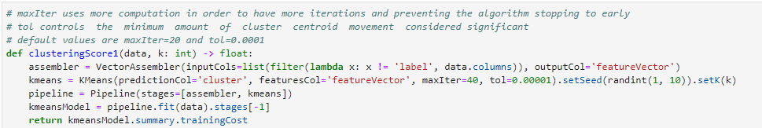
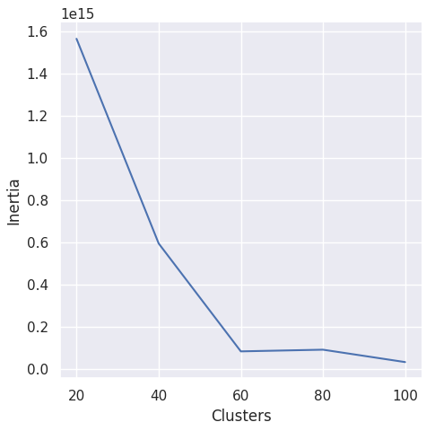
Initial k-means clustering
k=2 (default)
Notes:
Since K-means clustering requires numeric features, these either must be dropped or transformed into nonnumeric features. For now, features like “protocol_type” and “service” will be ignored. Using a VectorAssembler to create a feature vector, a standard KMeans implementation to create the model and setting these as stages for a Pipeline it’s possible to run a simple clustering task. With no processing, besides dropping nonnumeric features, we get the following results:
Only 2 clusters were formed (k=2), which is clearly not enough. Not only that, only one data point was assigned to cluster 1 while all others were assigned to cluster 0. This is an example of bad clustering. Many values of k must be tried in order to have a good clustering. Clustering is considered good if each data point is “near” its closest centroid. The main idea is to minimize the cost, in this case, the sum of squared distances of points to their nearest centroid.
Initially, the following values for k were tried: {20, 40, 60, 80, 100}. The following clustering function was used to compute the training cost for each value of k:
The score is now lower across the board. In any case, the goal is to find a value of k, which by increasing it stops reducing the training cost substantially. This will provide the best clustering / computation cost ratio

Slide 5
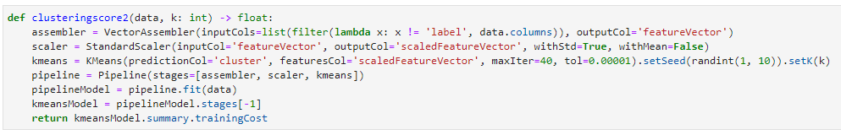

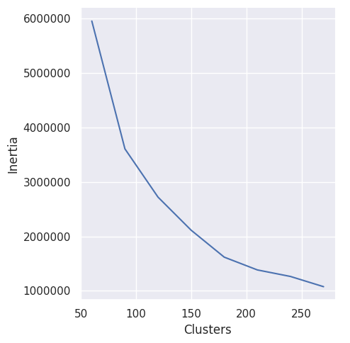
Feature normalization
Notes:
As with many machine learning algorithms, feature normalization can be very useful for clustering since it improves the numerical stability of the model and it changes the numeric distances between the nodes. Each feature value is converted to standard score using the formula
Where µ is the mean of the feature’s value and σ is the standard deviation. Feature normalization can be applied programmatically by using the StandardScaler class. After adding the StandardScaler to the clustering pipeline, the same test can be run with higher values of k

Slide 6
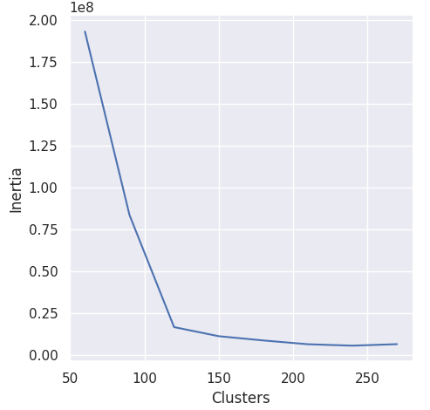
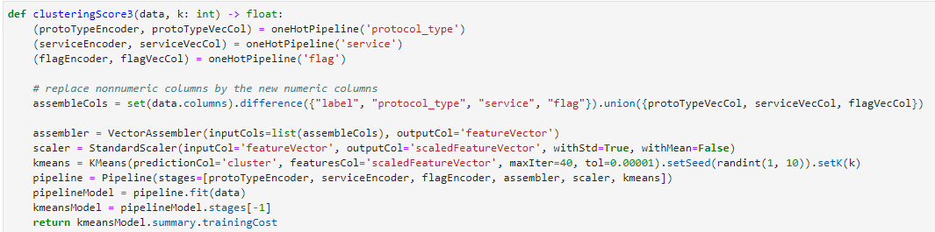
Categorical variables
Notes:
The nonnumeric features like “protocol_type” and “service” that were dropped before should be used since they provide valuable information. However, since KMeans clustering does not support nonnumeric features they must be transformed into numeric features. Using a StringIndexer and an OneHotEncoder it’s possible to perform this transformation and encode each of the new numeric values into a vector. This small pipeline was incorporated in the main clustering function as follows:

Slide 7
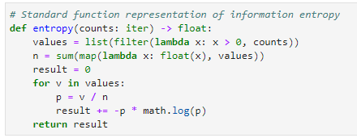
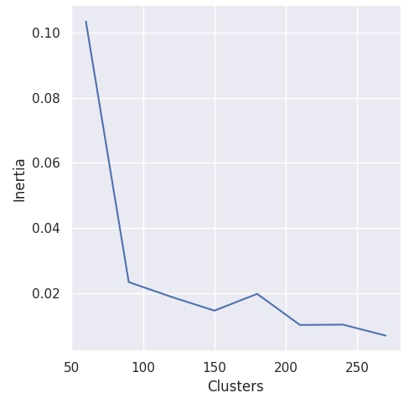

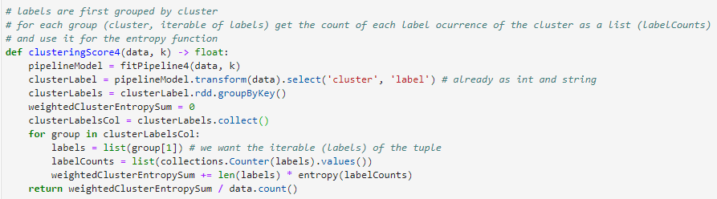
Entropy as cluster score
Notes:
Points labelled with the same value, for example, “smurf” should end up in one or two clusters. A good clustering should not group together points with many different labels. This is the principle of homogeneity. A weighted average of entropy can be used as a cluster score because it will validate the quality of the produced clusters. Low entropy means more homogeneity in the clusters.
Where S is represented by the result variable and 𝑃𝑖 is the probability derived by the fraction of 𝑣𝑖 and n (the sum of label counts).

Slide 8
Silhouette Coefficient
More sophisticated approach since it contrasts the average distance to elements in the same cluster with the average distance to elements in other clusters
The silhouette value ranges from -1 to 1 where a value closer to 1 indicates that the objects are well clustered and a value closer to -1 might indicate poor clustering configuration or presence of outliers
The ClusteringEvaluator class supports the use of the Silhouette Coefficient
Notes:
The main approach for the project consisted of using different values of k, that is, different numbers of clusters in multiple experiences to figure out the cost associated with it. The lower the cost(the sum of squared distances of points to their nearest centre) for a value k, the better the value. Typically, a greater value of k produces lower cost. However, it’s more computationally expensive so the goal was to pick a value of k where the cost started decreasing less, or not decreasing at all. This was easier to notice with an elbow graph. However, this approach is not completely reliable. As such, a more sophisticated approach used for picking a value for k is the silhouette coefficient. It contrasts the average distance to elements in the same cluster with the average distance to elements in other clusters. The silhouette value ranges from -1 to 1 where a value closer to 1 indicates that the objects are well clustered and a value closer to -1 might indicate poor clustering configuration or presence of outliers, meaning, excessive number of clusters or not enough clusters.

Slide 9
Gaussian Mixture and Bisecting k-means
Only 1% of the dataset used for Gaussian Mixture Model (about 50 000 connections)
The full dataset was used when using Bisecting k-means
Notes:
Different models were also applied, namely, Gaussian Mixture and Bisecting KMeans. However, these models are very computationally expensive and only one value of k was used for the experiment, which is 120. The previously defined clustering evaluator was used to measure the performance of both the algorithms For the Gaussian Mixture model, given it’s an extremely slow algorithm, only 1% of the dataset was used, about 50.000 connections which is more than enough data for clustering.

Slide 10
Results analysis and discussion

Slide 11
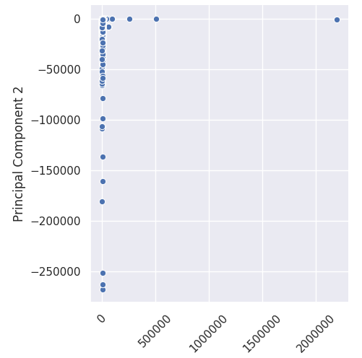
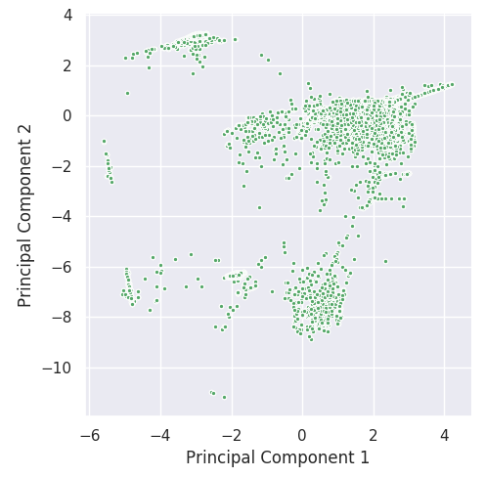
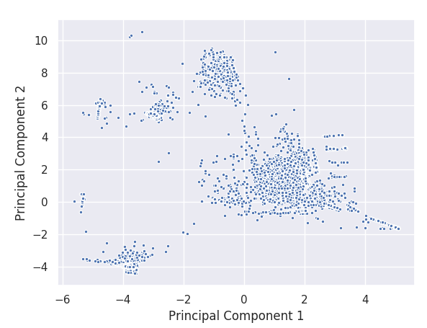
Using PCA for visualization
Pre-normalization
Post-normalization
With categorical features
Notes:
Using PCA (Principal Component Analysis), it’s possible to have a better understanding of the data and the features that have a greater weight on calculations. Since visualization is not possible using a Spark DataFrame and it’s not feasible to pull 4.9 million records to a non-distributed Pandas DataFrame only a sample of 1% (about 50.000 records) was used
This L-Shape makes sense since the features src_bytes and dst_bytes have values that are on a much larger scale than the other features, which have values 0 or 1. This also means that features must be normalized.

Slide 12
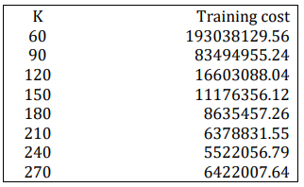
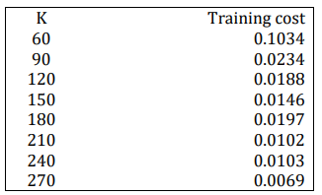
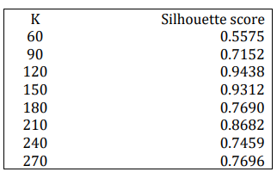
Results of different methods for picking k
K-means training cost
Entropy
Silhouette coefficient
Notes:
k=210 is ≈4623.41
In this case, the best value of k seems to be 120 since its respective silhouette score, ≈0.9438, is the closest to 1, indicating that data points are well clustered. Using the 100th-farthest point distance as a threshold as before the result is≈8688.4. The threshold value is greater, which makes sense, considering there are less clusters, which translates to greater distances from the centroids of each cluster to their farthest points

Slide 13
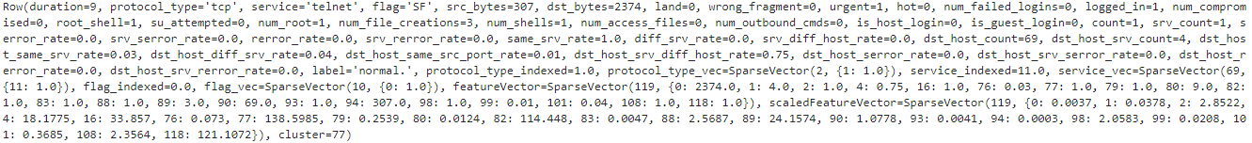
Detected anomalies with k-means
A connection is a potential anomaly if its distance to the nearest centroid exceeds a given threshold, in this case, the 100th-farthest data point
100 potential anomalies, roughly 0.00002% of the dataset, were found
Potential anomaly example
Notes:
A connection or data point is a potential anomaly if its distance to the nearest centroid exceeds a given threshold. For this anomaly detector, the threshold was defined as the 100th-farthest data point. The value of the distance, in this case, for k=210 is ≈4623.41
Some of the results found might not be obvious to a data scientist on why a given result is a potential anomaly. However, in this case, the connection has a value of 69 for the dst_host_count feature (69 connections to different hosts), even though it’s labelled as a normal connection. It was also possible to verify that, out of the 4.9 million connections present in the dataset, only 100 are potential anomalies, roughly 0.00002%. Obviously, given a lower threshold value the number of potential anomalies might be greater

Slide 14
Comparison of algorithms
Using the silhouette coefficient and k=120 the following results were obtained for each algorithm:
K-means ≈ 0.9438
Gaussian Mixture Model ≈ 0.5025
Bisecting k-means ≈ 0.4842
Both Gaussian Mixture Model and Bisecting k-means are very computationally expensive. Reasons for worse score
might include dimensionality of features, random seed picked for initialization, etc
Notes:
The computed silhouette score for this experiment, with k=120, is≈0.5025 which isn’t horrible but isn’t good either. For the Bisecting KMeans model, the full dataset was used. Albeit very computationally expensive, it’s still much faster than Gaussian Mixture Model. The computed silhouette score for this experiment, with k=120, is≈0.4842 which is even worse than the previous experience. Reasons for these scores were not explored and it might be due to multiple reasons. The value of k might not have been a good one, the random seed picked for initialization was not appropriate, or there are simply too many dimensions for the algorithms to be effective (especially in Gaussian Mixture). At least the Gaussian Mixture model should have provided better clustering considering it does not assume clusters spherical like KMeans. Moreover, maybe it does in other conditions.

Slide 15
Conclusion and future work
The essence of the problem (anomaly detection) is a great example to understand how clustering solutions work.
Picking a good value of k is the central, most important task, that a data scientist must do when implementing a clustering solution
Use different distance measures like Manhattan-distance
More investigation with Gaussian Mixture Model and other algorithms given more time and computational resources
Notes:
The essence of the problem described in this project, anomaly detection, is perfectly captured by the nature of clustering solutions like KMeans since these ultimately group data points into clusters. Any data point not inside the distance threshold of the cluster may be considered an anomaly. Picking a good value of k is one of the most important tasks that a data scientist must do when implementing a clustering solution. A value of k that is too high, in the limit, will provide a cluster for each data point while a value of k that is too low will increase the average diameter of the clusters and potentially group unrelated data points in the same cluster. Using cluster evaluating methods like the elbow graph, entropy score and the silhouette coefficient allow to get a better sense of how many clusters should be used. In problems like this, feature normalization also plays a big role since that step alone can completely change the output of a clustering pipeline, as seen previously. It decreases the cost (distance between data points) and prevents some features from drowning out other features. With the aid of visualization tools and PCA it’s also possible to see the distribution of the data, the most relevant features and how data points are clustered. It is also possible to verify that it’s relatively easy and relatively fast to cluster millions of data points using a vanilla KMeans algorithm implementation, at least when comparing with other algorithms like Gaussian Mixture or Bisecting KMeans.
With all this being said, the dataset can still be processed in many ways. While it was almost exclusively processed using KMeans with Euclidean distance by default, another distance measure like Manhattan-distance, implemented by k-medians, could be used, even though it’s not supported by Spark. Spark only supports Euclidian and Cosine distances, the latter one being used for textual problems. Given more time and computational resources, deeper investigation could be made involving Gaussian Mixture model and other algorithms.

